Slide 1
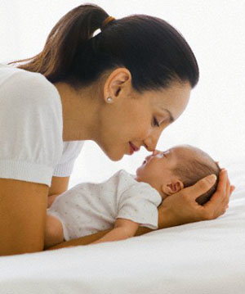
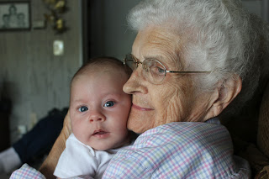
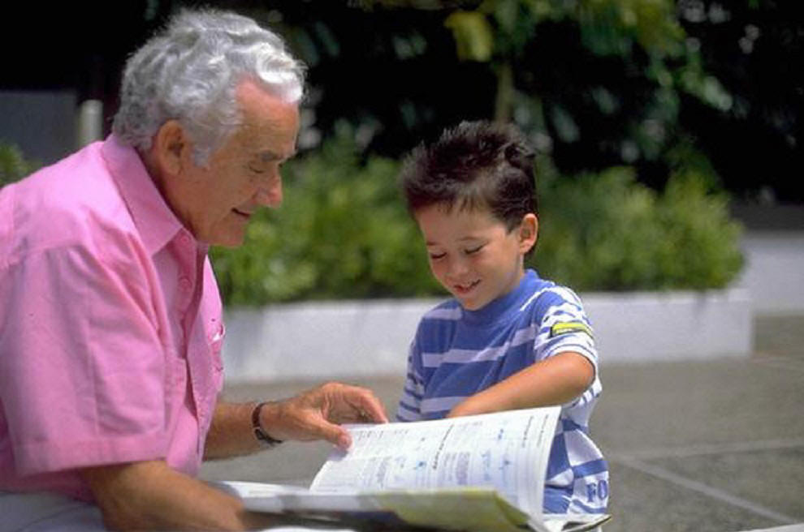
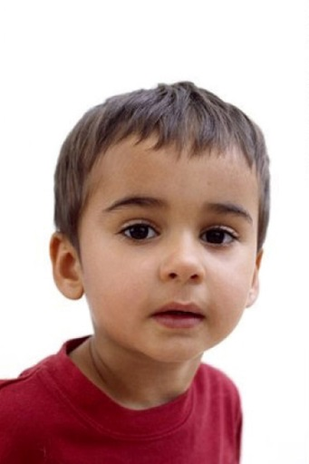
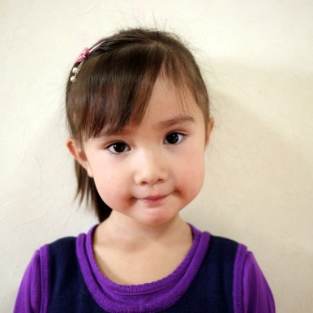
Mother
Father
Grandmother
madre
padre
abuela
Grandfather
Brother
Sister
abuelo
hermano
hermana

Slide 2
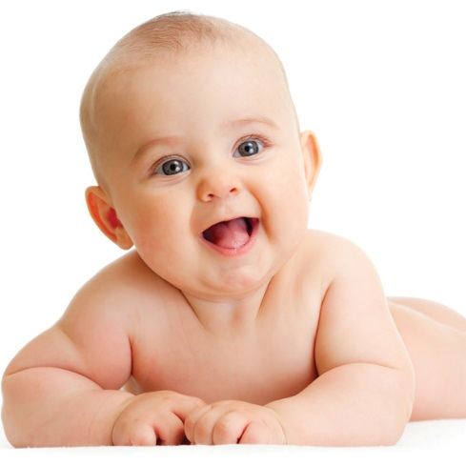
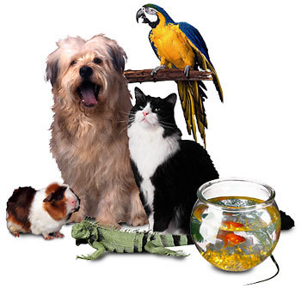
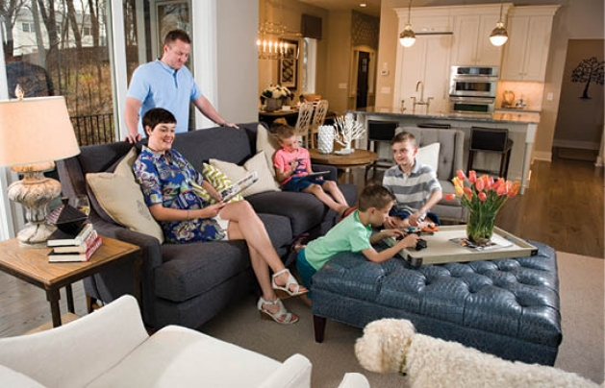
Baby
Pets
Family
bebé
familia
mascotas
Home
hogar

Slide 3
Mother
Father
Grandmother
madre
padre
abuela
Grandfather
Brother
Sister
abuelo
hermano
hermana

Slide 4
Baby
Pets
Family
bebé
familia
mascotas
Home
hogar

